Slide 1






Nazeefa Muzammil
Fellow
Yannick Stadtfeld
Fellow
Mahima Tendulkar
Fellow
Emmanuel Owusu Ahenkan
Fellow
Andrew Kitchen
Project Manager
Aygul Zagidullina
Technical Mentor
Predicting the risk of an individual becoming NEET

Slide 2
Definition
Not in
Education
Employment or
Training
Age 16
Age 24

Slide 3


Problem
4.5% NEET (aged 16-17)
14.5% NEET (aged 18-24)
in England
10 years
50% higher
remain disadvantaged in their level of attainment
risk of depression
and anxiety
2.5 times​
2.8 times​
higher chances to work in
low-status occupations
likely to be economically inactive

Slide 4

Goal
Create a data-driven solution to predict the risk of becoming NEET and provide intelligence for efficient and effective preventative interventions.

Slide 5

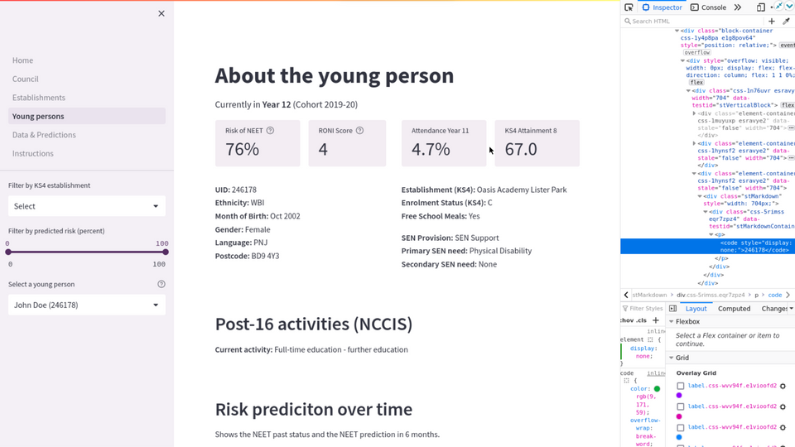
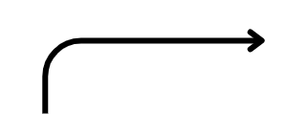



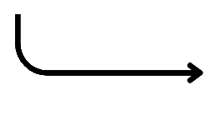
Solution
Identify datasets
Build a processing pipeline
Develop predictive models for decision making
Create an open-source visualisation tool
Council Data
Machine Learning
Algorithms
Post-16 Demographics
School Census
KS4 Attainment
NEET
Government Data
non-NEET
Socio-Economic Indicators
School Level Factors

Slide 6






Results
Actual
RONI Tool
NEET
non-NEET
NEET'22
NEET'23
NEET
Predicted
non-NEET

Slide 7

Results
Actual
RONI Tool
NEET
non-NEET
NEET'22
NEET'23
NEET
Predicted
non-NEET

Slide 8

Results
Actual
RONI Tool
NEET
non-NEET
NEET'22
NEET'23
NEET
Predicted
non-NEET

Slide 9
Results
Actual
RONI Tool
NEET
non-NEET
NEET'22
NEET'23
NEET
Predicted
non-NEET

Slide 10
Results
Actual
RONI Tool
NEET
non-NEET
NEET'22
NEET'23
NEET
Predicted
non-NEET

Slide 11
Results
Actual
RONI Tool
NEET
non-NEET
NEET'22
NEET'23
NEET
Predicted
non-NEET

Slide 12
Results
Actual
RONI Tool
NEET
non-NEET
NEET'22
NEET'23
NEET
Predicted
non-NEET

Slide 13
Results
Actual
RONI Tool
NEET
non-NEET
NEET'22
NEET'23
NEET
Predicted
non-NEET

Slide 14
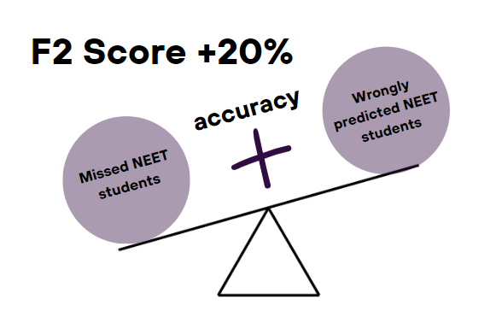
Results
Actual
RONI Tool
NEET
non-NEET
NEET'22
NEET'23
NEET
Predicted
non-NEET

Slide 15

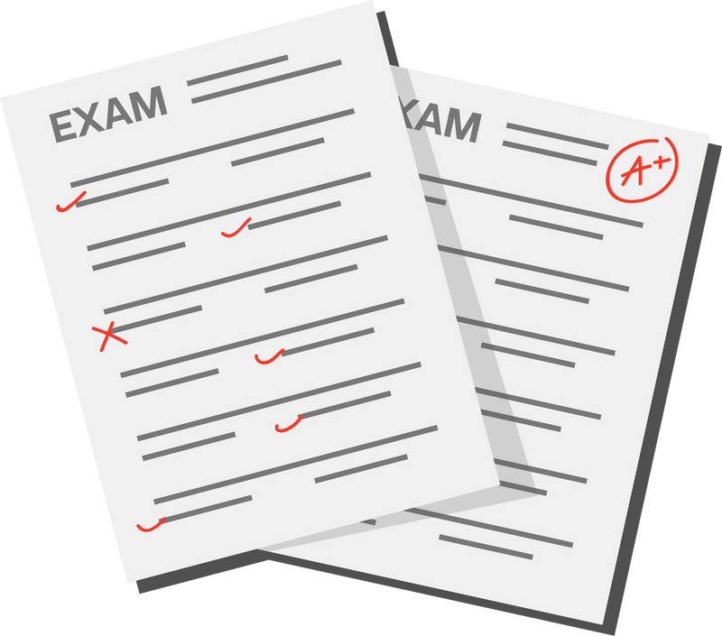


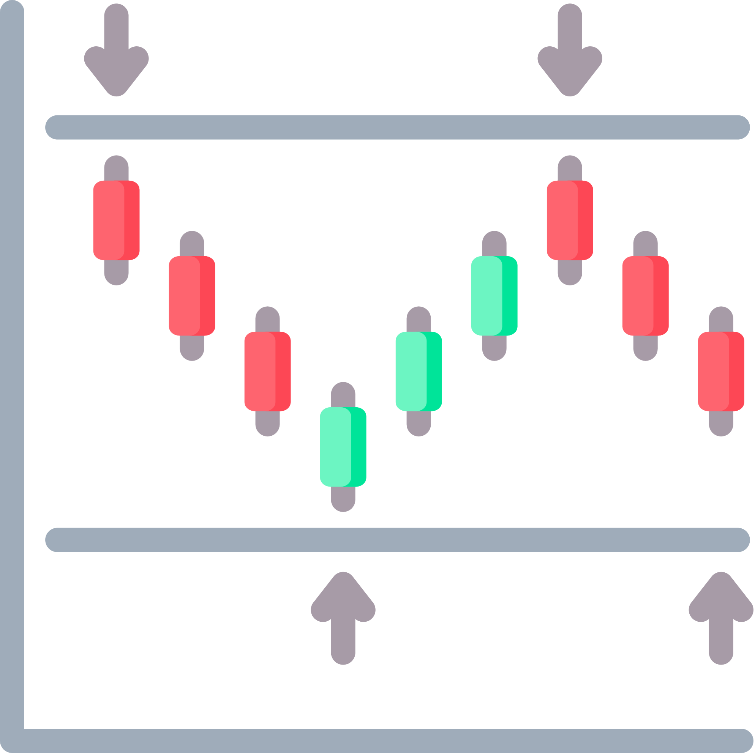




Insights
GCSE Attainment
School to Home Distance
Absences
Support Level
Free School Meals
Special Education Needs
Deprivation Indices

Slide 16



Impact
Non-discriminatory methodology.
Effective and efficient interventions
Potential to scale at a national level

Slide 17
Opportunities
1
3
Use centralised school data for upscaling nationally
Improve prediction performance
Refine using other councils' data
Develop approach to ethics and bias
2
4

Slide 18

Thank you for your time!
We are more than happy to
answer your questions at the poster session

